Slide 1
Lecture 11 Supplement – MapReduce Programming
CS4650 – Dr. Yang

Slide 2
MapReduce
Simplified data processing on large clusters
“A simple and powerful interface that enables automatic parallelization and distribution of large-scale computations, combined with an implementation of this interface that achieves high performance on large clusters of commodity PCs.”
Dean and Ghermawat, “MapReduce: Simplified Data Processing on Large Clusters”, Google Inc.

Slide 3
What is MapReduce？
A parallel programming model suitable for large-scale parallel data processing (i.e. big data processing)
Similar to divide-and-conquer method
Solving a large problem by partitioning into smaller tasks
Spilt data into distributable chunks(“shards”)
Define the step to process those chunks
Run that process in parallel on the chunks
Scalable by adding more machines to process chunks
Leverage commodity hardware to tackle big jobs
Scale out (note: scale out vs. scale up)
The foundation for Hadoop
MapReduce vs. Hadoop
MapReduce is a parallel programming model
Hadoop is a concrete platform that implements MapReduce

Slide 4
MapReduce Programming Model
Input: a set of input key/value pairs
Key can be omitted or default
Output: a set of output key/value pairs
Map: takes an input pair and produces a set of intermediate values associated with the same intermediate key, then passes them to the Reduce function
Reduce: merges these values together to form a possible smaller set of values
Typically just 0 or 1 output value per Reduce invocation

Slide 5
Example: WordCount
Problem statement
Count the occurrences/frequencies of the different words in the collection
Input (note: split the doc into file1/chunk1, file2/chunk2, …)
<file1, “How now brown cow”>
<file2, “How does it work now”>
Output (note: here in sorted order)
<brown 1>
<cow 1>
<does 1>
<How 2>
<it 1>
<now 2>
<work 1>

Slide 6
WordCount: Map and Reduce
Map
Process each file/chunk by a different map task
Each map task may run on different (virtual) machine
Reduce
Each reduce task receives a set of intermediate results from map tasks
Each reduce task summarizes and outputs its result
# of reduce tasks <= # of map tasks (most cases)
Each reduce task may run on different (virtual) machines
Data storage
Input data (to map task) and output data (out of reduce task) : on distributed file systems such as HDFS or GFS
Intermediate results: on local disks

Slide 7
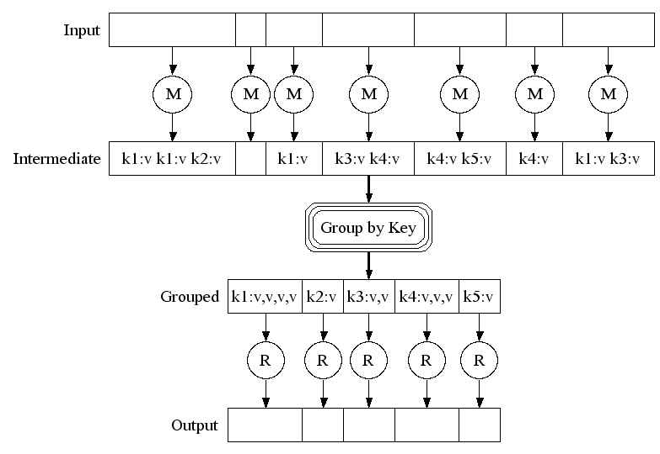
MapReduce Framework
www.cs.duke.edu/courses/fall10/cps216/Lectures/intro_to_mapreduce.ppt

Slide 8
Illustration of MapReduce Programming Model
M
<How,1>
<now,1>
<brown,1>
<cow,1>
<How,1>
<does,1>
<it,1>
<work,1>
<now,1>
How now
Brown cow
<How,1 1>
<now,1 1>
<brown,1>
<cow,1>
<does,1>
<it,1>
<work,1>
M
R
brown 1
cow 1
does 1
How 2
it 1
now 2
work 1
M
R
How does
It work now
M
Reduce
MapReduce
Framework
Map
Input
Output

Slide 9
Keys and Values
In MapReduce, no values stand its own
A key is associated with every value and these keys identify related values.
Key can be anything from a simple data types (int, float, etc) to file names to custom types.
Example: A log of time-coded speedometer readings from multiple cars could be keyed by license-plate number
AAA-123 65mph, 12:00pm
ZZZ-789 50mph, 12:02pm
AAA-123 40mph, 12:05pm
CCC-456 25mph, 12:15pm

Slide 10
Key-Value Pair: Examples
<docid, docitself>
<yourName, yourLifeHistory>
<graphNode, nodeCharacteristicsComplexData>
<yourId, yourFollowers>
<word, itsNumofOccurrences>
<planetName, planetInfo>
<geneNum, {pathway, geneExp, proteins}>
<Student, studentDetails>

Slide 11
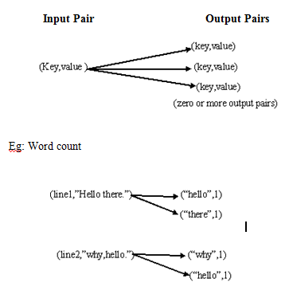
Key/value pairs

Slide 12
The Map Part of the MapReduce
Transform
Map input values to output values:<K1,V1> -> <K2,V2>
Input Key-Value Pairs
For instance, Key = line number, value= text string
Map Function
Step to transform input pairs to output pairs
For example, count the different words in the input
Output Key-Value Pairs
For example, key =<word>, Value = <count>
Map output is the input of the Reduce

Slide 13
The Reduce Part of the MapReduce
Merge(Reduce) Values from the Map phase
Reduce is optional. Sometimes all the work is done in the Mapper
Input
Values for a given key from all the Mappers
Reduce function
Steps to combine (sum, count, print….)the values
Output
Print values?, load into a DB? Send to the next MapReduce job?

Slide 14
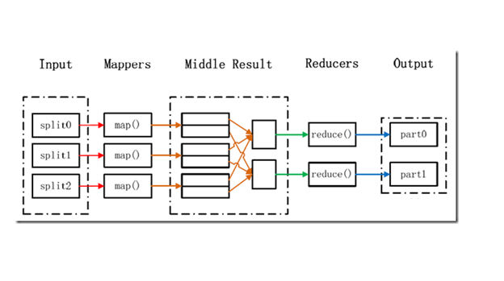
Mappers and Reducers

Slide 15
WordCount: map() and reduce()
map(String key, String value) {
// key: document name
// value: document contents
for each word w in value:
EmitIntermediate(w, "1");
}
reduce(String key, Iterator values) {
// key: a word
// values: a list of counts
int result = 0;
for each v in values:
result += ParseInt(v);
Emit(AsString(result));
}

Slide 16
Another view of map() and reduce()
1: class Mapper
2: method Map(docid a; doc d)
3: for all term t in doc d do
4: Emit(term t; count 1)
1: class Reducer
2: method Reduce(term t; counts [c1; c2; : : :])
3: sum = 0
4: for all count c in counts [c1; c2; : : :] do
5: sum = sum + c
6: Emit(term t; count sum)

Slide 17
Revisit: Word Count on XSEDE
Next slide is the example David presented in his guest lecture on XSEDE.
Please identify the complete process of map-reduce
Input -> mapper -> middle result (if any) -> reducer -> output
Key/value pair at input; and key/value pair at output

Slide 18
Example: Simple Counting
rdd= sc.textFile(“shakespeare.txt”)
rdd.count() #number of lines
words= rdd.flatMap(lambda x: x.split() )
words.count() #number of words
words.distinct().count() #number of distinct words
word_counts= words.map(lambda x: (x,1)) #create an rdd of tuples
.reduceByKey(lambda x,y: x+y) #reduce tuples by word
result= word_counts.map(lambda x: (x[1], x[0])) #swap key and value
.sortByKey(False) #sort by key, descending
result.take(5) #collect the top 5 (count, word) pairs

Slide 19
Another Example: Sorting in MapReduce
Imagine we have a huge dataset (i.e. 100s of files, and each file with millions) of integers that we have to sort.
MapReduce model is effective only if the data itself were not widely distributed i.e. the integers lie between a certain range and this range is quite small compared to size of the data
So we assume our data set (integers) is constrained between 100 to 200 and we have 5 files each containing 1000 random integers between 100 and 200 (so a total of 5000 integers between 100 and 200).

Slide 20
Sorting: Algorithm idea
MapReduce algorithm idea:
read each file into Map phase
in the Reduce phase, produce a final result containing the count of all the integers.
Now sort all the integers from the final Map and output it into a list data structure in the form of <Integer, Count>
In this way we have sorted all the data

Slide 21
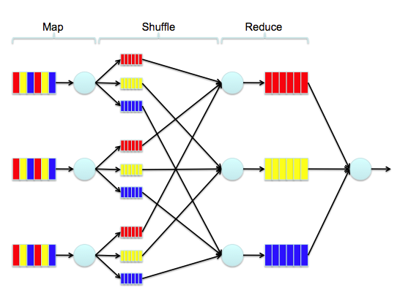
Sorting: Dataflow Illustration
http://www.cs.uml.edu/~jlu1/doc/source/report/MapReduce.html

Slide 22
Map and Reduce: Theory
Map:
(in_key, in_value) -> list_of (out_key, intermediate_value)
or, Map(<k1,v1>) → list(<k2,v2>)
Reduce:
(out_key, list_of(intermediate_value)) -> list_of(out_value)
Or, Reduce(<k2, list (v2)>) → list(v3)
WordCount example
Map(file1, “how now hello how”) → (<how,1>, <now, 1>, <hello, 1>, <how, 1>)
Reduce(<how, (1, 1)>) -> (2)

Slide 23
MapReduce process (one result per reduce process)
Machine 1
Machine 2
…
Machine n
<k1, v1>
<k1, v1>
<k1, v1>
Map
Map
Map
List(<k2, v2>)
List(<k2, v2>)
List(<k2, v2>)
(Optional)
Combine
Combine
Combine
List(<k2, List(v2)>)
List(<k2, List(v2)>)
List(<k2, List(v2)>)
SHUFFLE
k2, list (v2)
k2, list (v2)
k2, list (v2)
Reduce
Reduce
Reduce
k2, v3
k2, v3
k3, v3

Slide 24
(multiple results per one reduce process)
Machine 1
Machine 2
…
Machine n
<k1, v1>
<k1, v1>
<k1, v1>
Map
Map
Map
List(<k2, v2>)
List(<k2, v2>)
List(<k2, v2>)
(Optional)
Combine
Combine
Combine
List(<k2, List(v2)>)
List(<k2, List(v2)>)
List(<k2, List(v2)>)
SHUFFLE
List(<k2, List (v2)>)
List(<k2, List (v2)>)
List(<k2, List (v2)>)
Reduce
Reduce
Reduce
List(<k2, v3>)
List(<k2, v3>)
List(<k3, v3>)

Slide 25
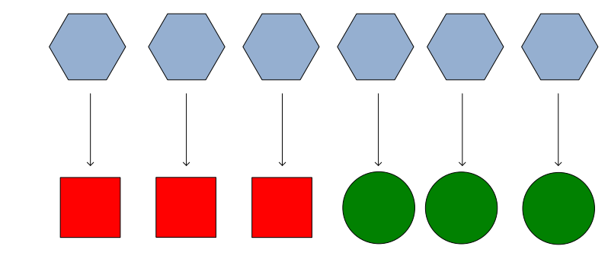
Map

Slide 26
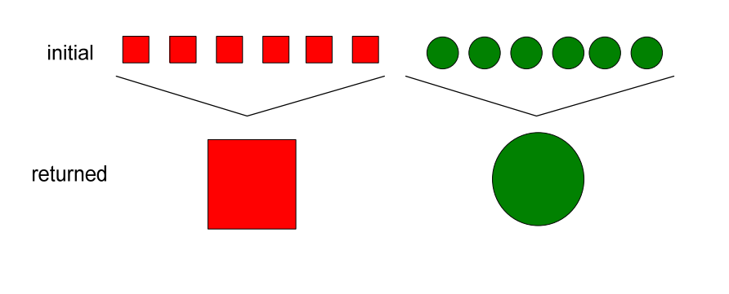
Reduce

Slide 27
Parallelism
map() functions run in parallel, creating different intermediate values from different input data sets
reduce() functions also run in parallel, each working on a different output key
All values are processed independently
Bottleneck: reduce phase can’t start until map phase is completely finished

Slide 28
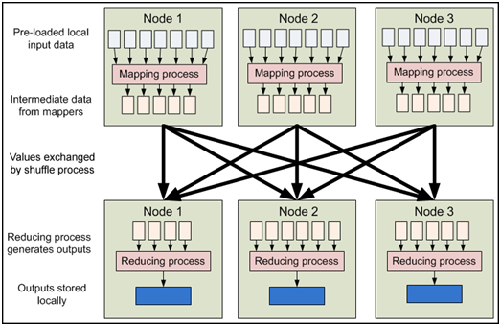
MapReduce Dataflow
http://www.j2eebrain.com/java-J2ee-mapreduce.html

Slide 29
More on MapReduce: Combining Phase -- Optimization
Run on mapper nodes after map phase
“Mini-reduce,” only on local map output
Used to save bandwidth before sending data to full reducer
Reducer can be combiner
Multiple-layers of Reducer possible

Slide 30
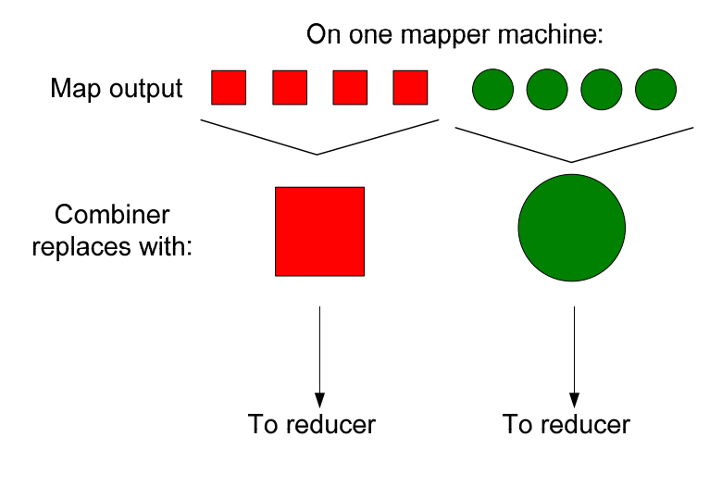
Combine – on local node

Slide 31
Example
This is a cat
Cat sits on a roof
The roof is a tin roof
There is a tin can on the roof
Cat kicks the can
It rolls on the roof and falls on the next roof
The cat rolls too
It sits on the can

Slide 32
Mapper
Output of Mappers:
<this 1> <is 1> <a 1> <cat 1> <cat 1> <sits 1> <on 1><a 1> <roof 1>
<the 1> <roof 1> <is 1> <a 1> <tin 1 ><roof 1> <there 1> <is 1> <a 1> <tin 1><can 1> <on 1><the 1> <roof 1>
<cat 1> <kicks 1> <the 1><can 1> <it 1> <rolls 1> <on 1> <the 1> <roof 1> <and 1> <falls 1><on 1> <the 1> <next 1> <roof 1>
<the 1> <cat 1> <rolls 1> <too 1> <it 1> <sits 1> <on 1> <the 1> <can 1>

Slide 33
Reducer
Input to the reducer: (sorted by key)
..
<can <1, 1>>
<cat <1,1,1,1>>
…
<roof <1,1,1,1,1,1>>
..…
Reduce (sum in this case) the counts (note: count comes out sorted!)
..
<can 2>
<cat 4>
..
<roof 6>

Slide 34
Questions
Who combines the result to the following format? The mapper? The reducer? Or other?
<can <1, 1>>
<cat <1,1,1,1>>
How the results get sorted?

Slide 35
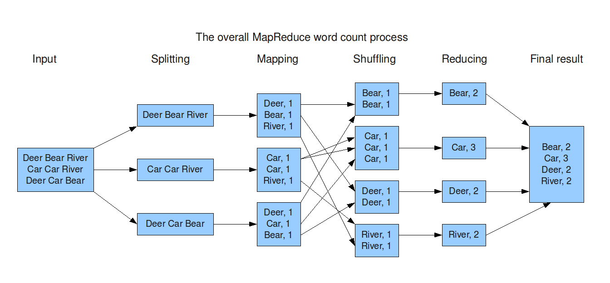

Slide 36
Mapper with Combiner
This is a cat
Cat sits on a roof
<this 1> <is 1> <a <1,1,>> <cat <1,1>> <sits 1> <on 1> <roof 1>
The roof is a tin roof
There is a tin can on the roof
<the <1,1>> <roof <1,1,1>> <is <1,1>> <a <1,1>> <tin <1,1>> <there 1> <can 1> <on 1>
Cat kicks the can
It rolls on the roof and falls on the next roof
<cat 1> <kicks 1> <the <1,1>> <can 1> <it 1> <roll 1> <on <1,1>> <roof <1,1>> <and 1> <falls 1> <next 1>
The cat rolls too
It sits on the can
<the <1,1>> <cat 1> <rolls 1> <too 1> <it 1> <sits 1> <on 1> <cat 1>

Slide 37
Using a combiner function
A combiner function is defined using the Reducer interface
Usually it is the same implementation as the reducer function
Combiner must be specified in the configuration file (JobConf)
Example :
public class MaxTemperatureWithCombiner {
public static void main(String[] args) throws IOException {
JobConf conf = new JobConf(MaxTemperatureWithCombiner.class);
conf.setJobName("Max temperature");
FileInputFormat.addInputPath(conf, new Path(args[0]));
FileOutputFormat.setOutputPath(conf, new Path(args[1]));
conf.setMapperClass(MaxTemperatureMapper.class);
conf.setCombinerClass(MaxTemperatureReducer.class); //set combiner
conf.setReducerClass(MaxTemperatureReducer.class);
conf.setOutputKeyClass(Text.class);
conf.setOutputValueClass(IntWritable.class);
JobClient.runJob(conf);
}
}

Slide 38
Partitioner/Reorder/Shuffle/Sort/…
Many (optional) local/middle tasks may be added
Details in lecture 5b
WordCount Example again
Assume
Node A: <hi, 1> <hello, 1> <world, 1> <bye 1> <world 1>
Node B: <hello, 1> <hadoop, 1> <goodbye 1> <hadoop 1>
Node C is scheduled to perform the reduce function of key starting with ‘h’

Slide 39
Node C: Reorder first, then Reduce
3. Reduce data to
<hadoop, 2>
<hello, 2>
<hi, 1>
1. Assume receiving data from network in this order
<hello, 1>
<hi, 1>
<hadoop, 1>
<hadoop, 1>
<hello, 1>
2. Rearranges data
<hadoop, 1>
<hadoop, 1>
<hello, 1>
<hello, 1>
<hi, 1>

Slide 40
Node C: reduce first, then reorder
same as above
reduce data to
<hello, 2>
<hi, 1>
<hadoop, 2>
Reorder the reduced data to
<hadoop, 2>
<hello, 2>
<hi, 1>
Advantage: less # of key/value pairs to be sorted

Slide 41
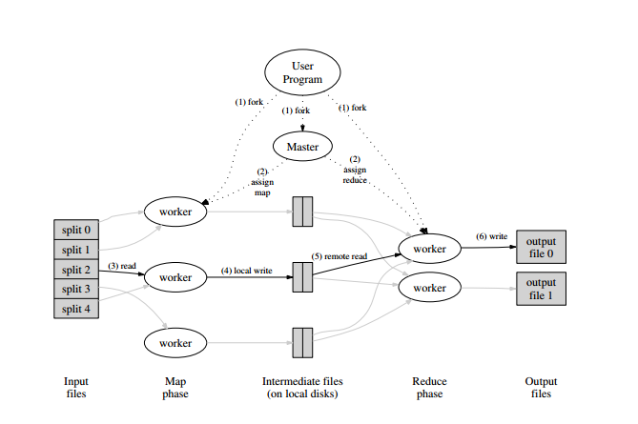
MapReduce Framework
Dean and Ghermawat, “MapReduce: Simplified Data Processing on Large Clusters”, Google Inc.

Slide 42
Tasks in each phase of the framework
MapReduce library in the user program first splits the input files into M pieces, it then starts many copies of the program on a cluster of machines
Typically 16 MB to 64 MB per piece
Controllable by user via an optional parameter

Slide 43
2. One of the copies of the program is the master, the rest are workers
Workers are assigned work by the master
There are M map tasks and R reduce tasks to assign
the master picks idle workers and assigns each one a map task or a reduce task

Slide 44
3. A map worker (worker assigned a map task) reads the contents of the corresponding input split. It parses key/value pairs out of the input data nd passes each pair to the user-defined map() function
The intermediate key/value pairs produced by the map() function are buffered in memory

Slide 45
4. Periodically, the buffered pairs are written to local disk, partitioned into R regions by the partitioning function.
the locations of these buffered pairs on the local disk are passed back to the master, who is responsible for forwarding these locations to the reduce workers

Slide 46
5. When a reduce worker is notified by the master about these locations, it uses remote procedure calls to read the buffered data from the local disks of the map workers
when a reduce worker has read all intermediate data, it sorts it by the intermediate keys so that all occurrences of the same key are grouped together
the sorting is needed because typically many different keys map to the same reduce task
if the amount of intermediate data is too large to fit into memory, an external sort is used

Slide 47
6. The reduce worker iterates over the sorted intermediate data and for each unique intermediate key encountered, it passes the key and the corresponding set of intermediate values to the user’s reduce() function
The output of the reduce() function is appneded to a final output file for this reduce partition

Slide 48
7. When all map tasks and reduce tasks have been completed, the master wakes up the user program
At this point, the MapReduce call in the user program returns back to the user code

Slide 49
Some issues – pair input requirement
In step 3, it suggests that input splits are processed or transformed into key/value pairs before feeding into a map() function
This is logically valid, but not practically necessary
i.e. no necessary to process data in this restricted key/value way
Hadoop, an open source implementation of MapReduce does not require input of map() function in key/value form

Slide 50
Some issues – reordering & reduce
Step 5 and Step 6 require sorting of intermediate results
This may result in inefficient usage of framework resource
Question
Should we do reordering first then reduce?
Or, reduce first and then reordering?
See previous WordCount example

Slide 51
Applications of WordCount
Word frequency counts (of course)
Seasonal flu report
Google’s prediction vs. CDC prediction
Unofficial example
URL access frequency
How useful a particular URL is can be evaluated by how frequently it is referenced
Internet search engine (such as Google, Yahoo, …) logs user’s choices of search results
assume in the form of <URL₁, userID₁>, <URL₂, userID₂>, …
In the MapReduce framework, map tasks scan through the logs and produce <URL, 1> pairs and Reduce tasks use distinct URLs as keys to output <URL, total_count>

Slide 52
Reversed web-link graph
Another crucial indicator of how useful a website is can be determined by how many other websites has links pointing toward it
Obtain snapshots of websites, fed to map tasks to generate <target, source> pairs
Assume the input in the form of <source, <target_1, target_2, …, target_k>>, …
Using target as a key, reduce tasks aggregate all sources to a list, i.e. <target, list(source)>

Slide 53
Inverted index
An important method to speed up results of internet research engine
Build up an index, containing a list of URLs which the word appears in
Similar to index at the end of a book, replace the page numbers that a particular word appears with a list of URLs that the word appears
Fed snapshots of websites to map tasks, producing <word, URL> pairs
Assume input has the form of <URL, <w1, w2, …, wk>>
Reduce tasks collect URLs according to each word

Slide 54
Term-vector per host
How relevant a URL to keywords inputted by users can be determined more properly by considering all keywords at the same time instead of separately as if the keywords are not related
Fed snapshots of websites to map tasks, producing <<URL>, <word, 1>> pairs
The first Reduce phase combines the about pairs into <URL, list(<word, 1>)> according to each distinct URL
The second Reduce phase will further combine list(<word, 1>) into list(<word, frequency>)
For each URL, only some words (keywords) in the word frequency is kept to form a term vector for a URL
The final output is <URL, (word₁, word₂, …, word_{i})>

Slide 55
Other applications
Graph algorithm
Shortest distance
Natural Language Processing
Unstructured text mining
extracting “features” from a document
Text mining: CS599 by Dr. Manna
Machine learning
“vectorize” documents
Clustering
Classification
Decision trees
Naïve Bayesian classifier
Scoring
…

Slide 56
Advantages of MapReduce
Fault Tolerance
Master monitors the cluster throughout the MapReduce execution
For example, when potential failure of a map task is spotted
Master will schedule another map execution on another node
Depending on computation resources and availability of input data
If original execution completes and returns data correctly first, the newly started map execution will be abandon

Slide 57
Data locality
Before execution starts, required input splits have to be local in nodes that will perform the map task
Input data may not be in local in general
This step could easily overload the network when moving input data to their destinations
To solve such challenging performance issues
Google File System (GFS) spreads across the whole cluster by default for redundancy and availability

Slide 58
Load balancing
Plays an role in any cluster environment
In MapReduce
master creates and terminates all the tasks
Master tries to spread tasks across the whole cluster as evenly as possible
O(M+R) scheduling decisions
Scheduling algorithm – CS537

Slide 59
Scaling
A large cluster means more computation resources
but may also increase overhead
In MapReduce
Map tasks and reduce tasks are independent
Good for parallel execution
The number of map and reduce tasks (M+R) limits the scaling potential
But it also makes it easy to add/delete nodes

Slide 60
MapReduce: Review and Summary
Map function maps one <key,value> space to another. One to many: “expand” or “divide”
Reduce does that too. But many to one: “merge”
There can be multiple “maps” in a single machine…
Each mapper(map) runs parallel with and independent of the other (think of a bee hive)
All the outputs from mappers are collected and the “key space” is partitioned among the reducers. (what do you need to partition?)
Now the reducers take over. One reduce/per key (by default)
Reduce operation can be anything.. Does not have to be just counting…(operation [list of items]) – You can do magic with this concept.

Slide 61
Practice
Use a small set of data to illustrate a map-reduce problem solving model
E.g. WordCount
Start with 2-3 lines of made-up sentences
Work out 2-3 paragraphs selected from your favorite article
Try simple model (map/reduce) first
Add combiners and other optimizations
E.g. Sorting
Then extend to the problem solving strategy for large datasets

